Slide 2
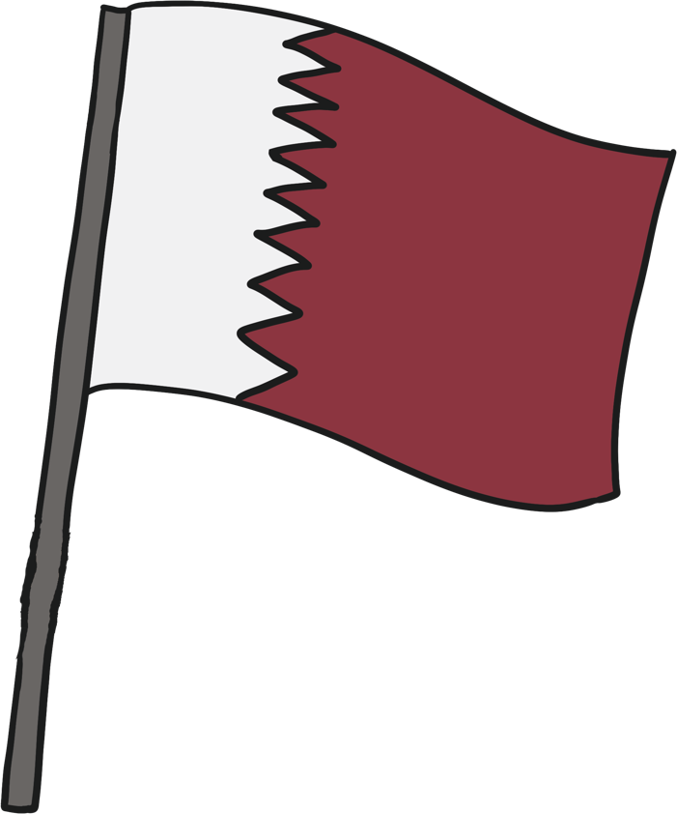
National Flag
The flag of Qatar is maroon with a white zigzag.
There are 9 points.
The maroon colour is said to have been made from shellfish found on the Bin Ghannam Island.
The sun turned this reddish dye to maroon.
The maroon colour is called ‘Al Ad’aam’.

Slide 3
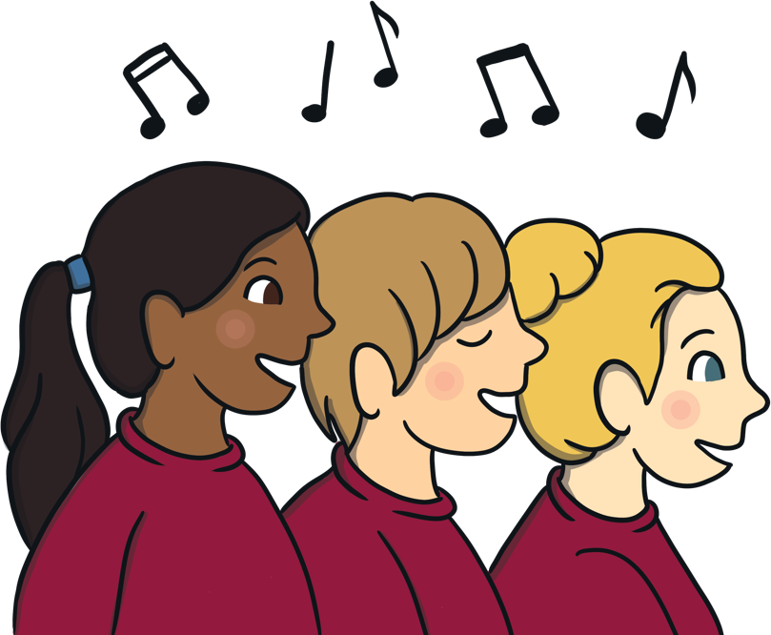
National Anthem
The national anthem of Qatar is called ‘As Salam al Amiri’.
It officially became the National Anthem in 1996.

Slide 4
National Language
The national language of Qatar is Arabic.
Most children learn Arabic at school.
Arabic is the official language but English is spoken by many people.

Slide 5
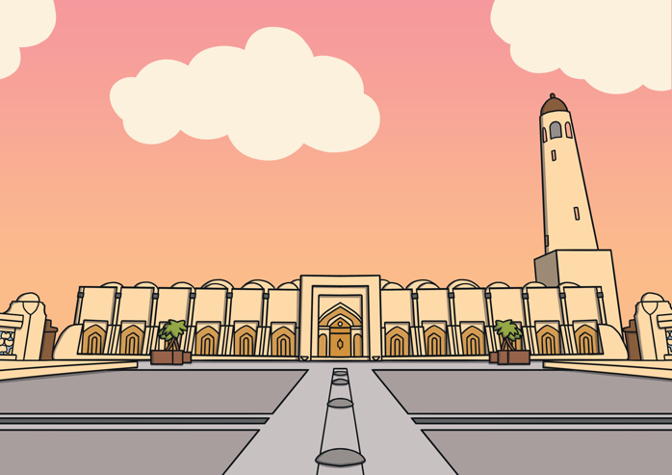
National Religion
The national religion of Qatar is Islam.
Most Qataris are Muslim.
There are many mosques for people to use.
The largest mosque in Qatar is the Qatar State Grand Mosque or the Imam Muhammad bin Abdul Wahhab Mosque.

Slide 6
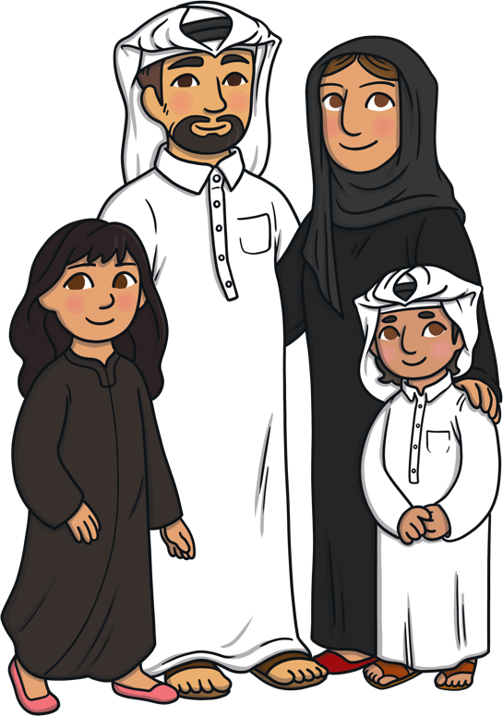
National Clothing
The national clothing for men is a thobe.
A thobe is a long white shirt.
Men also wear a headdress which is usually white or red and white checkered fabric.
The women wear an abaya which is a long black dress which is worn over their other clothes.
They also wear a shayla which is a headscarf.

Slide 7
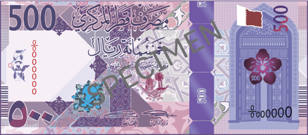
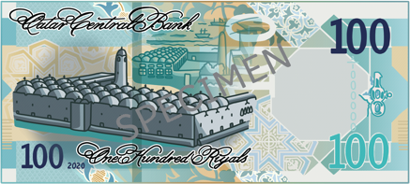
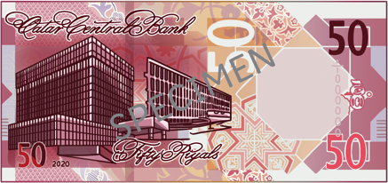
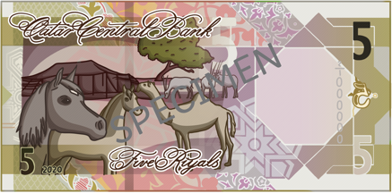
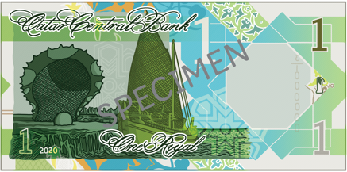
National Currency
The national currency is the Qatari Riyal.
There are 100 dirhams in one Riyal.
The Qatari Riyal was first used in 1967.
You can get 25 and 50 dirham coins and notes that are 1, 5, 10, 50, 100, 200 and 500 Riyals.

Slide 8
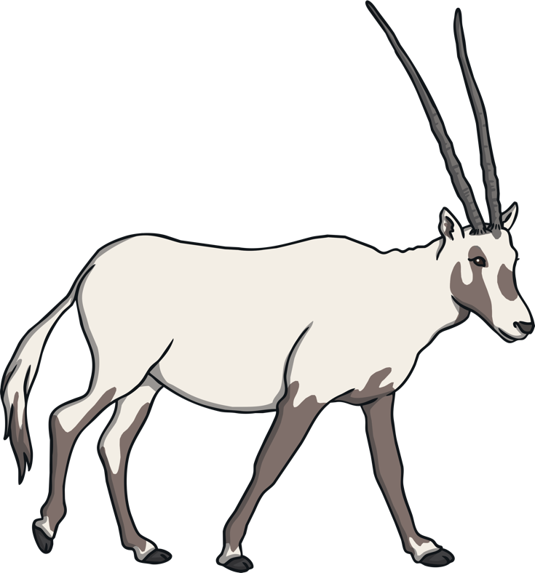
National Animal
The national animal is the Arabian Oryx.
It is able to live in the hot and dry desert.
It does not need a lot of water and gets most of the water it needs from the plants that it eats.

Slide 9
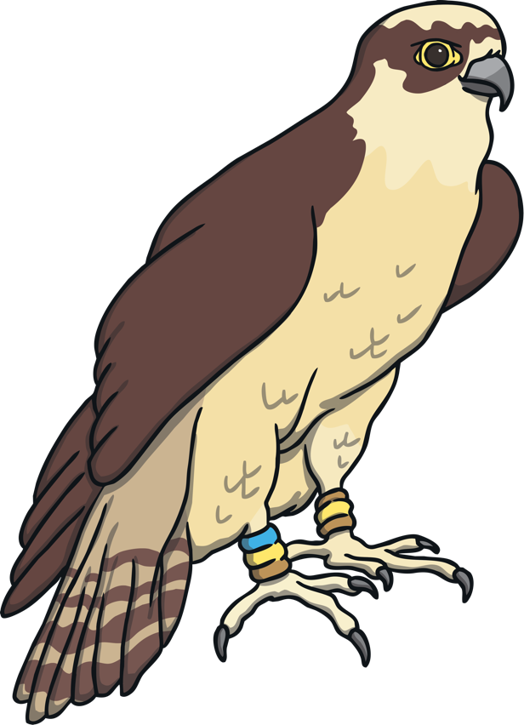
National Bird
The national bird of Qatar is the falcon.
Falconry is a traditional form of hunting.
It is said to have started about 5,000 years ago.
Falcons are very expensive.

Slide 10
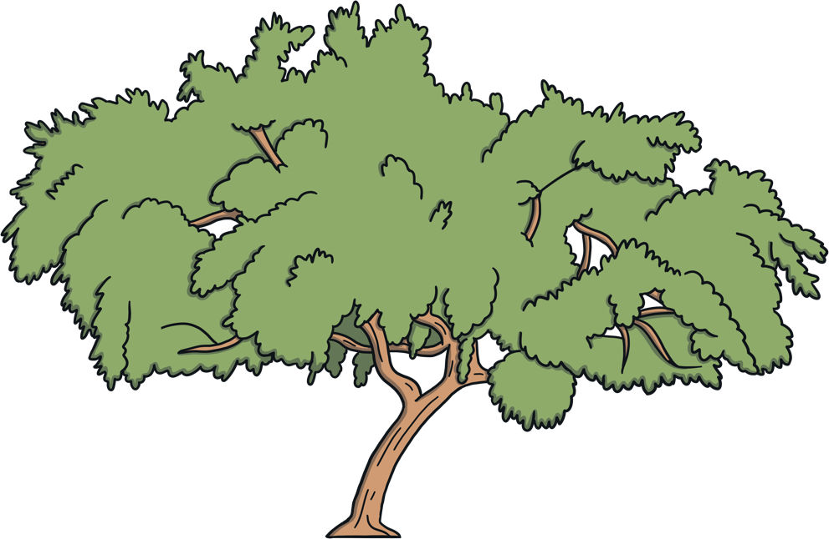
National Tree
The national tree of Qatar is the Sidra Tree.
It uses very little water and grows well in the hot desert climate of Qatar.

Slide 11
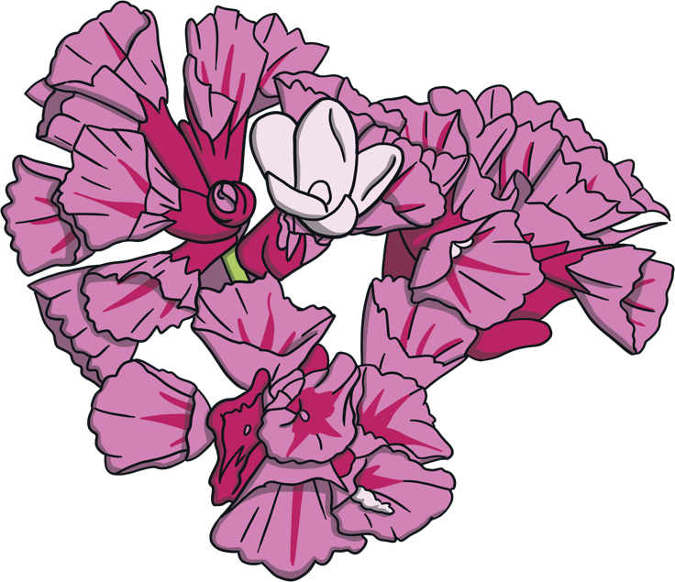
National Flower
The national flower of Qatar is the Qataf.
It grows along the beaches.
The flowers can be seen between March and May.
It has pink or purple flowers that grow in groups.

Slide 12
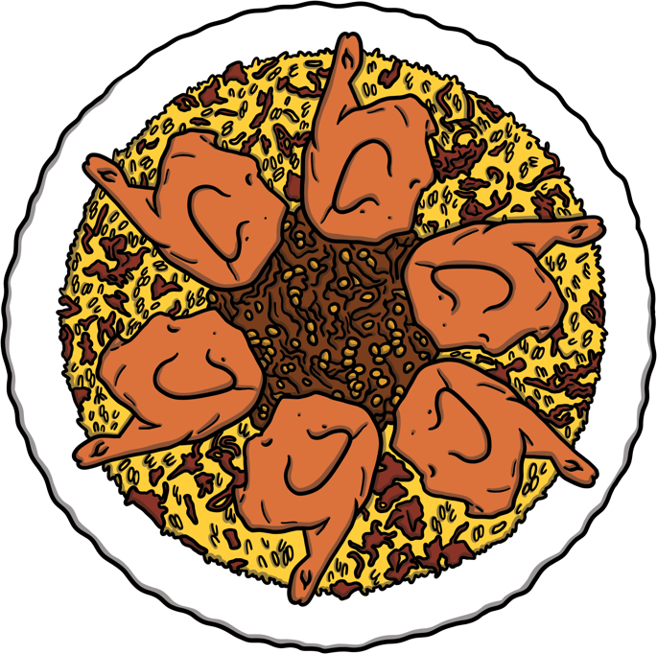
National Dish
The national dish of Qatar is Machboos.
It is made from rice and chicken or lamb.
It is one of the most popular dishes in Qatar.

Slide 13
Rules in Qatar that may be considered a crime punishable under Qatari law
For Key Stage 2 Only
Drinking alcohol in public.
Filming or photographing people and religious, military or construction sites.
Posting videos and photographs online that appear to insult, slander or are culturally insensitive.
Dressing immodestly when in public, including while driving.
Women must cover their shoulders.
Both men and women are advised not to wear shorts or sleeveless tops.
Holding hands in public.
Homosexual behaviour (Y5 & Y6 only)

